Slide 1
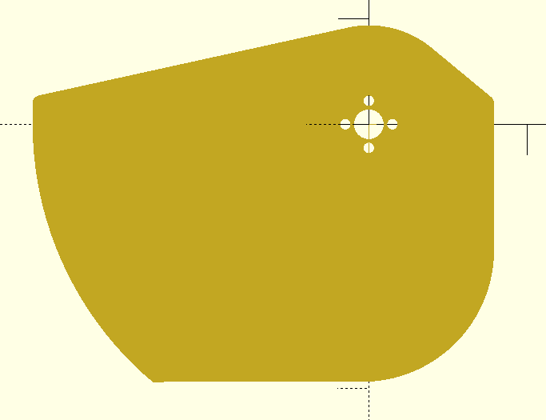
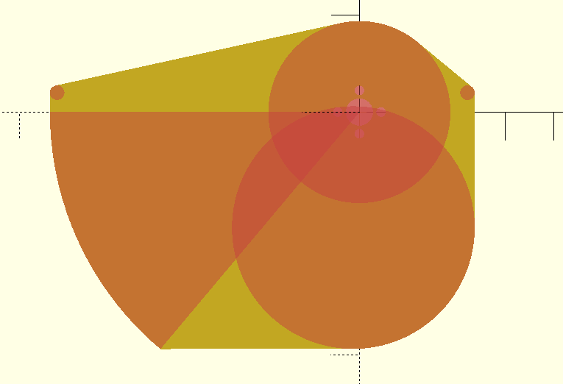
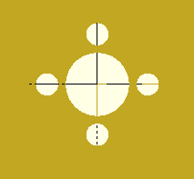
Shooter base plate core – Use this as the starting sketch for the shooter top and bottom plates. The motor mount pattern is centered on the origin for all measurements
BearingD = 14.2 / 25.4 (14.2mm = 0.559”) BallDiameter = 5.0” FlywheelDiameter = 3.75” FlywheelClearance = (FlywheelDiameter / 2) + 0.5” BallCompression = 0.2” (NOTE : NOT 0.25” as I previously said!!) ShooterInnerCurveRadius = (FlywheelDiameter / 2) + BallDiameter - BallCompression; CurveBallPathSegmentAngle = 50 degrees CurveBallPathExtension = 0.4” M4FreeHoleD = 4.1 / 25.4 (4.1mm = 0.161417”) ShooterPlateT = 0.18” UpperBallTractionGap = 1.0” UpperBallTractionLocation = [-0.4”, -3.3”] ServoBlockLength = 2.7”
Plate outline is the ‘hull’ around the primitives. Use tangential lines
Diameter = FlywheelDiameter : Center = [0, 0]
Diameter = 0.3” : Center = [FlywheelClearance - (0.3 / 2), CurveBallPathExtension]
Diameter = 0.3” : [-ShooterInnerCurveRadius + .3 + (0.3 / 2), CurveBallPathExtension]
Diameter = 5” : Center = [FlywheelClearance - (5” / 2), -4.88 + (5” / 2)]
Radius = ShooterInnerCurveRadius - 0.3”, Arc = CurveBallPathSegmentAngle : Center = [0, 0]
8mm = 8/25.4” = 0.31496”
Diameter = BearingD
Diameter = M4FreeHoleD

Slide 2
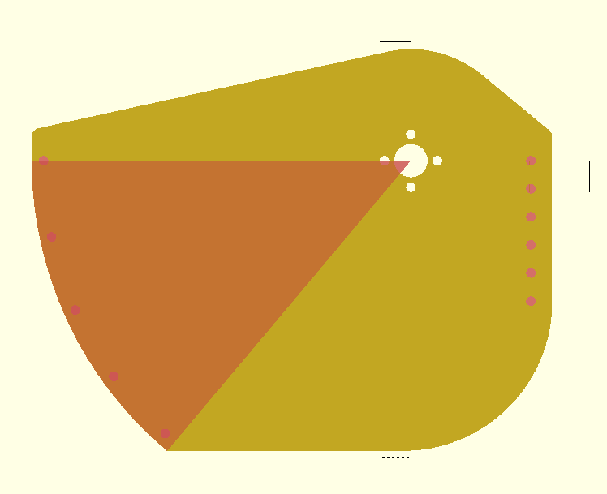
Mounting holes
Radius = ShooterInnerCurveRadius - 0.3” - 0.2”
Angle = 12 degrees
12 / 25.4 (12mm = 0.47244”)
5 holes evenly spaced
FlywheelClearance - ShooterPlateT - (4 / 25.4)
4mm = 0.15748”

Slide 3
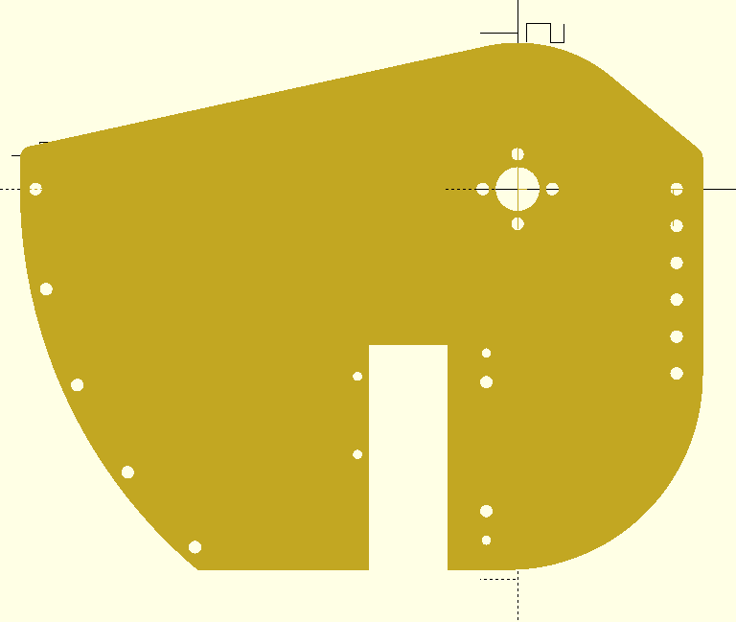
Shooter base plate top starts with the above Shooter base plate core and adds the following holes
Corner coordinates : X = UpperBallTractionLocation[X] - UpperBallTractionGap - 0.5” Y = UpperBallTractionLocation[Y] - 1.7”
4mm
3mm
(ServoBlockLength / 2) – 0.15”
1.0”
0.827”
0.827”
(ServoBlockLength / 2) – 0.15”
UpperBallTractionLocation
4mm
UpperBallTractionGap
Coordinates : X = UpperBallTractionLocation[X] - UpperBallTractionGap - 0.8” Y = UpperBallTractionLocation[Y] - 0.1”

